Slide 1

RECOMMENDATION SYSTEM
Under the guidance of D.BALU CHANDER(153)
A .SIRISHA MAM BARGHAV VUPPU(154)

Slide 2
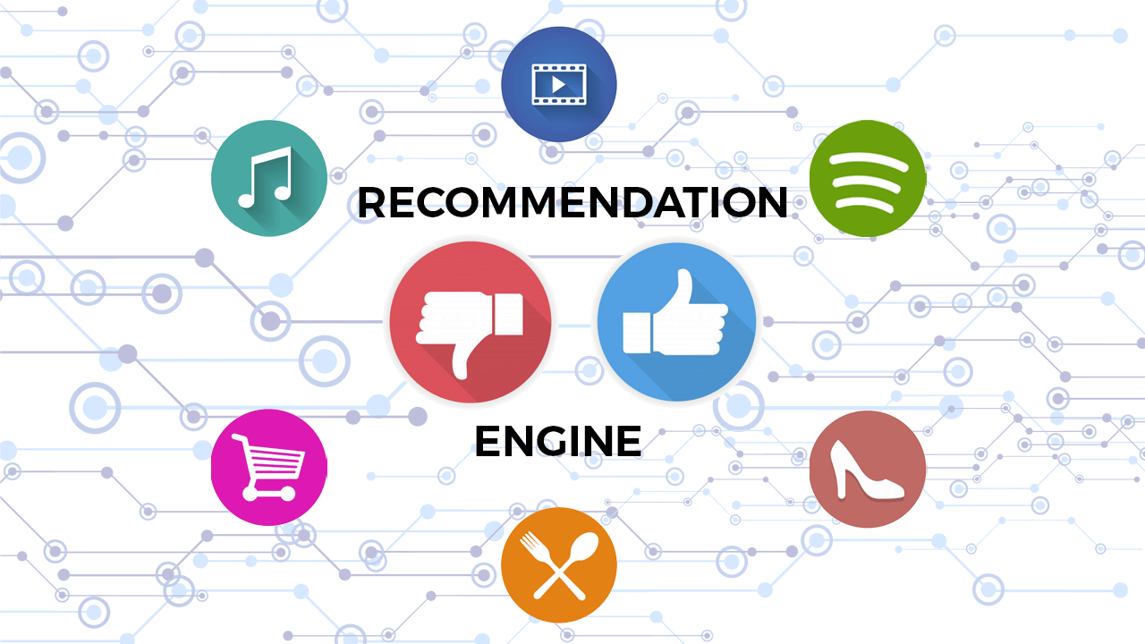
WHAT IS RECOMMENDATION SYSTEM
Recommendation system is an information filtering technique, which provides users with information, which he/she may be interested in.
Recommender systems are used in a
variety of areas, with commonly
recognised examples taking the form of :
Playlist generators for video and music
services
Product recommenders for online stores
Content recommenders for social media platforms and open web content recommenders.

Slide 3

Collaborative filtering
It is a method finds a subset of user who have similar tastes and preferences to find the target user and use this subset for
offering recommendations.
Basic assumptions:
user with similar interests have
common preferences.
Sufficiently large number of user
preferences are available.

Slide 4
ADVANTAGES
We don't need domain knowledge because the embeddings are automatically learned.
To some extent, the system needs only the feedback matrix to train a matrix factorization model.
In particular, the system doesn't need contextual features. In practice, this can be used as one of multiple candidate generators.
Cannot handle fresh items
The prediction of the model for a given (user, item) pair is the dot product of the corresponding embeddings.
So, if an item is not seen during training, the system can't create an embedding for it and can't query the model with this item.
This issue is often called the cold-start problem.
LIMITATIONS

Slide 5
TECHNOLOGIES USED
Html
CSS
Python
Machine learning
Streamlit
Heroku

Slide 6
HOME PAGE
COURSE RECOMMENDATION
ABOUT PAGE
RECOMMENDATION
SYSTEM
INTERNSHIPS RECOMMENDATION

Slide 7
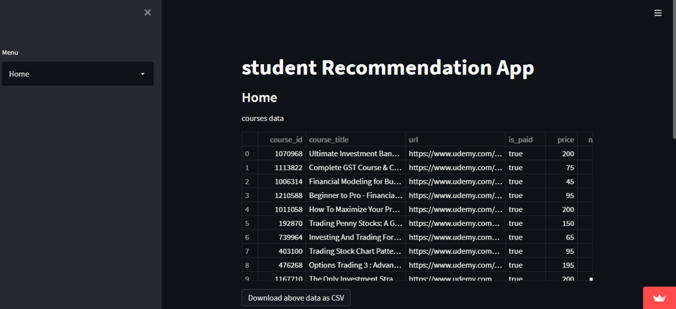
HOME PAGE

Slide 8
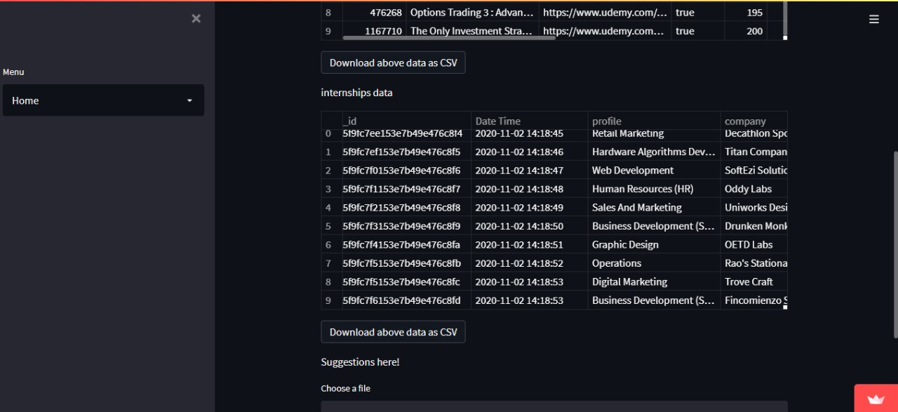

Slide 9

COURSES SEARCH BAR

Slide 10
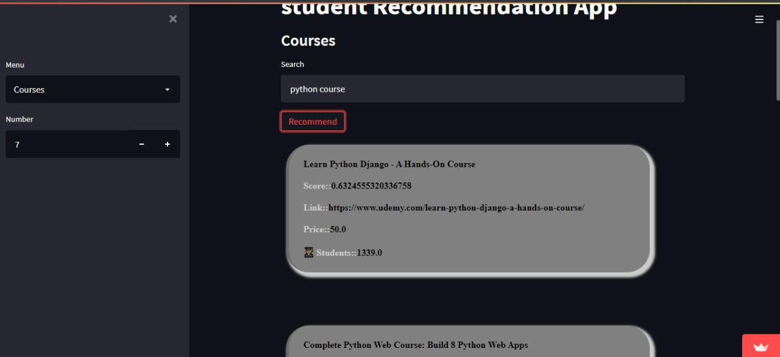
COURSE RECOMMENDATIONS

Slide 11
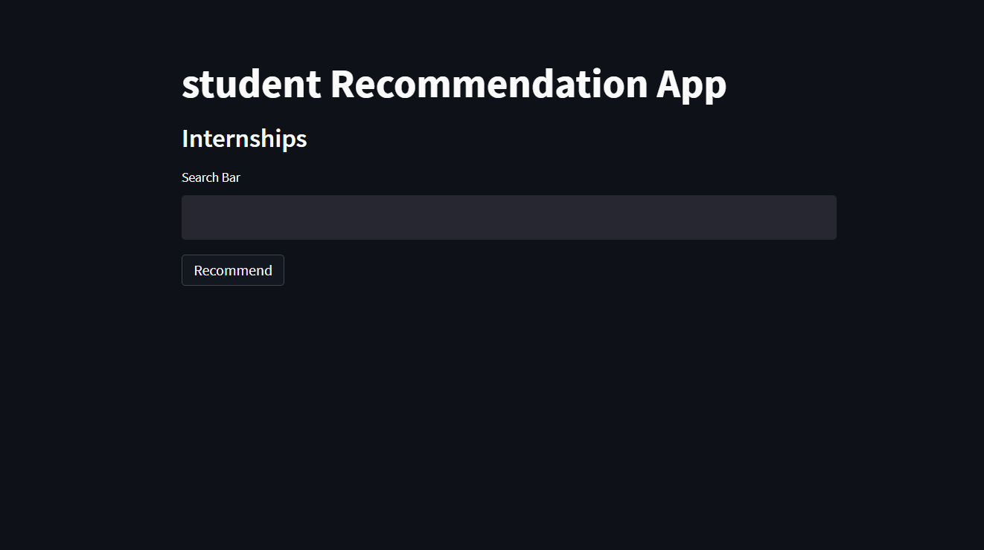
INTERNSHIPS SEARCH BAR

Slide 12
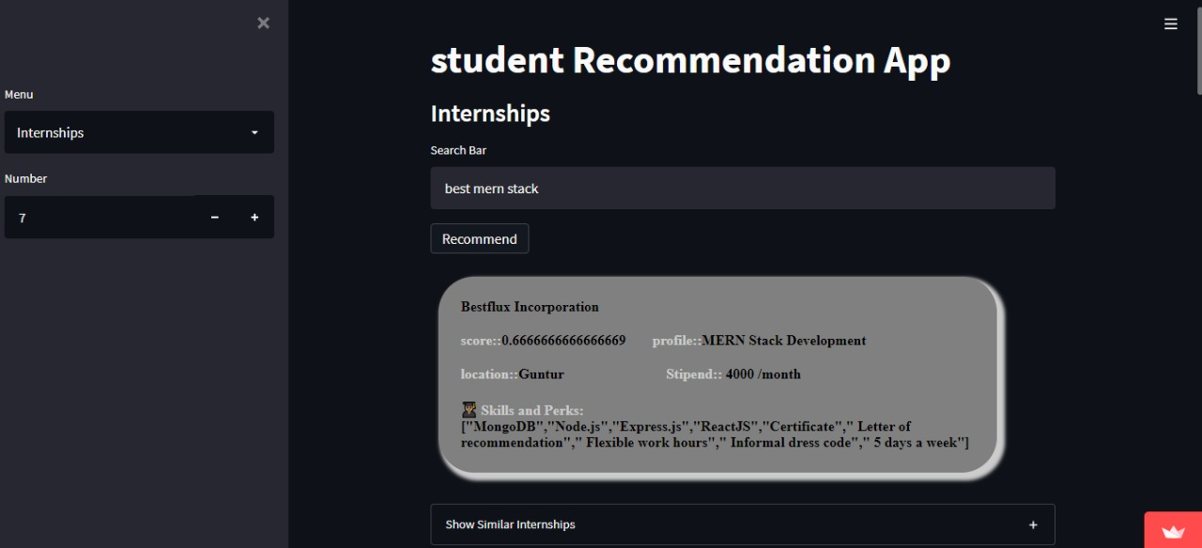
INTERNSHIP RECOMMENDATIONS

Slide 13
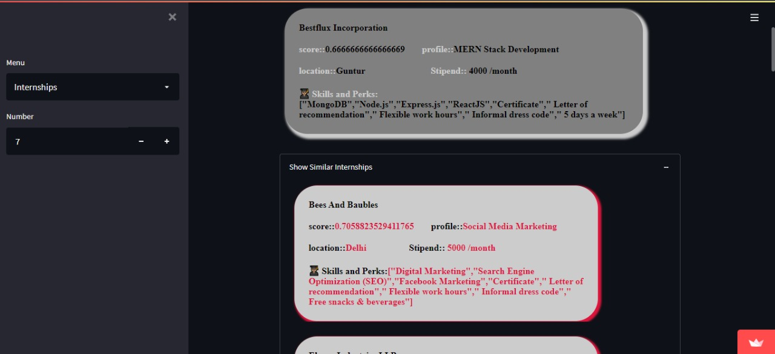
SIMILAR INTERNSHIPS

Slide 14
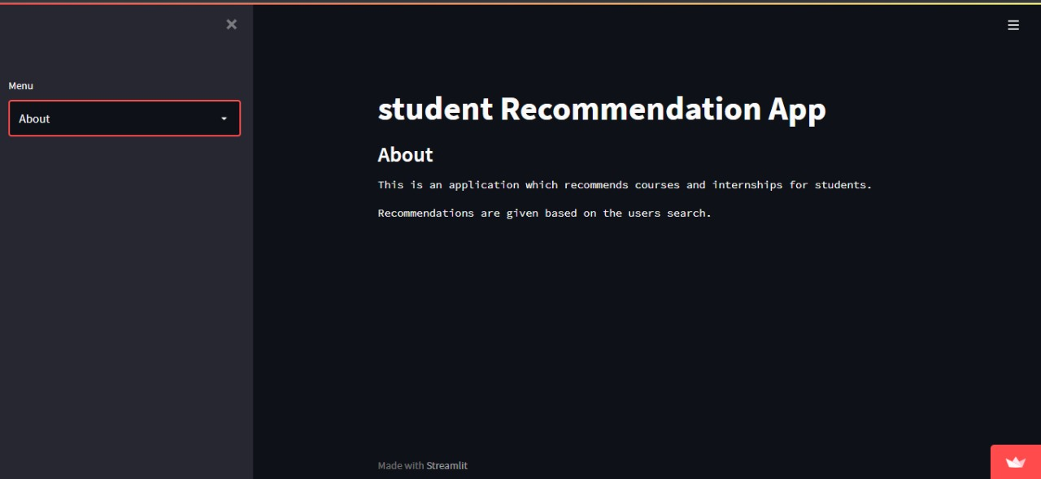
ABOUT PAGE

Slide 15
CONCLUSION AND FUTURE SCOPE
The primary goal of this research project is to create a course and internship recommender system that provides personalized recommendations to students of CBIT.
In this thesis, we have used Collaborative Filtering for building a recommender system .
The current solution is simple and straightforward. Some students may not prefer any of the popular courses or internships.
In the future, we may create a more efficient system with considering many more attributes for cosine similarity.

Slide 16
THANK YOU
BALU CHANDER YADAV.D--(160119737153)
BHARGHAV VUPPU--(160119737154)

